Slide 1
Fault Tolerance in Distributed Systems
05.05.2005
Naim Aksu

Slide 2
Agenda
Fault Tolerance Basics
Fault Tolerance in Distributed Systems
Failure Models in Distributed Systems
Reliable Client-Server Communication
Hardware Reliability Modeling
  Series Model
  Parallel Model
Agreement in Faulty Systems:
  Two Army problem
  Byzantine Generals problem
Replication of Data
Highly Available Services: Gossip Architectures
Reliable Group Communication
Recovery in Distributed Systems

Slide 3
Introduction
Hardware, software and networks cannot be totally free from failures
Fault tolerance is a non-functional (QoS) requirement that requires a system to continue to operate, even in the presence of faults
Fault tolerance should be achieved with minimal involvement of users or system administrators (who can be an inherent source of failures themselves)
Distributed systems can be more fault tolerant than centralized (where a failure is often total), but with more processor hosts generally the occurrence of individual faults is likely to be more frequent
Notion of a partial failure in a distributed system
In distributed systems the replication and redundancy can be hidden (by the provision of transparency)

Slide 4
Faults
Faults: attributes, consequences and strategies
Attributes
Availability
Reliability
Safety
Confidentiality
Integrity
Maintainability
Consequences
Fault
Error
Failure
Strategies
Fault prevention
Fault tolerance
Fault recovery
Fault forcasting

Slide 5
Faults, Errors and Failures
Fault
Error
Failure
Fault is a defect within the system
Error is observed by a deviation from the expected behavior of the system
Failure occurs when the system can no longer perform as required (does not meet spec)
Fault Tolerance is ability of system to provide a service, even in the presence of errors

Slide 6
Fault Tolerance in Distributed Systems
System attributes:
· Availability – system always ready for use, or probability that system is ready or available at a given time
· Reliability – property that a system can run without failure, for a given time
· Safety – indicates the safety issues in the case the system fails
· Maintainability – refers to the ease of repair to a failed system
Failure in a distributed system = when a service cannot be fully provided
System failure may be partial
A single failure may affect other parts of a system (failure escalation)

Slide 7
Fault Tolerance in Distributed Systems
Fault tolerance in distributed systems is achieved by:
Hardware redundancy, i.e. replicated facilities to provide a high degree of availability and fault tolerance
Software recovery, e.g. by rollback to recover systems back to a recent consistent state upon detection of a fault

Slide 8
Failure Models in Distributed Systems
Scenario: Client uses a collection of servers...
Failure Types in Server
Crash – server halts, but was working ok until then, e.g. O.S. failure
Omission – server fails to receive or respond or reply, e.g. server not listening or buffer overflow
Timing – server response time is outside its specification, client may give up
Response – incorrect response or incorrect processing due to control flow out of synchronization
Arbitrary value (or Byzantine) – server behaving erratically, for example providing arbitrary responses at arbitrary times. Server output is inappropriate but it is not easy to determine this to be incorrect. E.g. duplicated message due to buffering problem. Alternatively there may be a malicious element involved.

Slide 9
Reliable Client-Server Communication
Client-Server semantics works fine providing client and server do not fail. In the case of process failure the following situations need to be dealt with:
Client unable to locate server
Client request to server is lost
Server crash after receiving client request
Server reply to client is lost

Slide 10
Reliable Client-Server Communication
Client unable to locate server, e.g. server down, or server has changed
Solution
- Use an exception handler – but this is not always possible in the programming language used
Client request to server is lost
Solution
- Use a timeout to await server reply, then re-send – but be careful about idempotent operations
- If multiple requests appear to get lost assume ‘cannot locate server’ error

Slide 11
Reliable Client-Server Communication
Server crash after receiving client request. Problem may be not being able to tell if request was carried out (e.g. client requests print page, server may stop before or after printing, before acknowledgement)
Solutions
- Rebuild server and retry client request (assuming ‘at least once’ semantics for request)
- Give up and report request failure (assuming ‘at most once’ semantics) what is usually required is exactly once semantics, but this difficult to guarantee
Server reply to client is lost
Solution
- Client can simply set timer and if no reply in time assume server down, request lost or server crashed during processing request.

Slide 12
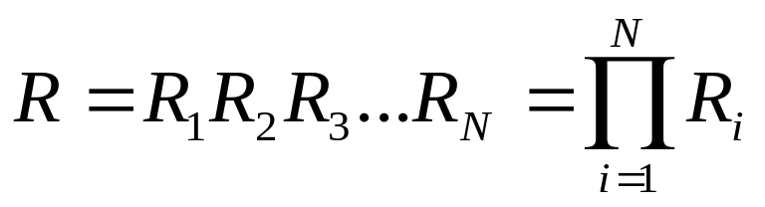
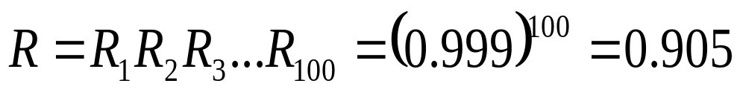
Hardware Reliability Modeling
Series Model
Failure of any component 1 .. N will lead to system failure
Component i has reliability Ri
System reliability
E.g. system has 100 components, failure of any component will cause system failure. If individual components have reliability 0.999 what is system reliability
R1
R2
RN

Slide 13
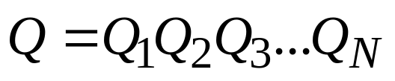
Hardware Reliability Modeling
Parallel Model
System works unless all components fail
Connecting components in parallel provides system redundancy reliability enhancement
R = reliability, Q=Unreliability
System Unreliability:
E.g. system consists of 3 components with reliability 0.9, 0.95 and 0.98, connected in parallel. What is overall system reliability:
R = 1-(1-.9)(1-.95)(1-.98) = 1-0.1*0.05*0.02 = 1-0.0001
so R = 0.99990

Slide 14
Agreement in Faulty Systems
How to reach agreement within a process group when 1 or more members cannot be trusted to give correct answers

Slide 15
Agreement in Faulty Systems
Used to elect a coordinator process or deciding to commit a transaction in distributed systems
Use majority voting mechanism which can tolerate K faulty out of 2K+1 processes
(K fails, K+1 majority OK)
Need to guard against collusion or conspiracies to fool
Goal of distributed systems is to have all non faulty processes agreeing, and reaching agreement in a finite number of operations.

Slide 16
Example 1: Two Army Problem
Enemy Red Army has 5000 troops
Blue Army has two separate gatherings, Blue(1) and Blue(2), each of 3000 troops. Alone Blue will loose, together as a coordinated attack Blue can win
Communications is by unreliable channel (send a messenger who may be captured by red army so may not arrive
Scenario:
Blue(1) sends to Blue(2) “lets attack tomorrow at dawn”
later, Blue(2) sends confirmation to Blue(1) “splendid idea, see you at dawn”
but, Blue(1) realizes that Blue(2) does not know if the message arrived
so, Blue(1) sends to Blue(2) “message arrived, battle set”
then, Blue(2) realizes that Blue(1)does not know if the message arrived etc.
The two blue armies can never be sure because of the unreliable communication. No certain agreement can be reached using this method.

Slide 17
Example 2: Byzantine Generals Problem
The communications is reliable but processes are not.
Precondition
Enemy Red Army, as before, but Blue Army is under control of N generals (encamped separately)
M (unknown) out N generals are traitors and will try to prevent the N-M loyal generals reaching agreement.
Communication is reliable by one to one telephone between pairs of generals to exchange troop strength information
Problem
How can the blue army loyal generals reach agreement on troop strength of all other loyal generals?
Postcondition
If the ith general is loyal then troops[i] is troop strength of general i. If the ith general is not loyal then troops[i] is undefined (and is probably incorrect)

Slide 18
Algorithm
Algorithm (by Lamport e.g. for N=4, M=1)
Each general sends a message to the N-1 (i.e. 3) other generals. Loyal generals tell truth, traitors lie.
The results of message exchanges are collated by each general to give vector[N]
Each general sends vector[N] to all other N-1 (3) generals
Each general examining each element received from the other N-1 look for the majority response for each blue general
Algorithm works since traitor generals are unable to affect messages from loyal generals. Overcoming M traitor generals requires a minimum 2M+1 loyal (3M+1 generals in total).

Slide 19
Replication of Data
Goal - maintaining copies on multiple computers (e.g. DNS)
Requirements
Replication transparency – clients unaware of multiple copies
Consistency of copies
Benefits
Performance enhancement
Reliability enhancement
Data closer to client
Share workload
Increased availability
Increased fault tolerance
Constraints
How to keep data consistency (need to ensure a satisfactorily consistent image for clients)
Where to place replicas and how updates are propagated
Scalability

Slide 20
Fault Tolerant Services
Improve availability/fault tolerance using replication
Provide a service with correct behaviour despite n process/server failures, as if there was only one copy of data
Use of replicated services
Operations need to be linearizable and sequentially consistent when dealing with distributed read and write operations (see Coulouris).
Fault Tolerant System Architectures
  Client (C)
  Front End (FE) = client interface
  Replica Manager (RM) = service provider

Slide 21
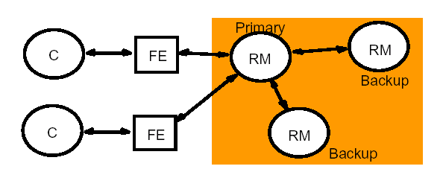
Passive Replication
All client requests (via front end processes) directed to nominated primary replica manager (RM)
Single primary RM together with one or more secondary replica managers (operating as backups)
Single primary RM responsible for all front end communication – and updating of backup RM’s
Distributed applications communicate with primary replica manager, which sends copies of up to date data.
Requests for data update from client interface to primary RM is distributed to each backup RM
If primary replica manager fails a secondary replica manager observes this and is promoted to act as primary RM
To tolerate n process failures need n+1 RM,s
Passive replication cannot tolerate Byzantine failures

Slide 22
Passive Replication – how it works
Request is issued to primary RM, each with unique id
Primary RM receives request
Check request id, in case request has already been executed
If request is an update the primary RM sends the updated state and unique request id to all backup RM’s
Each backup RM sends acknowledgment to primary RM
When ack. is received from all backup RM’s the primary RM sends request acknowledgment to front end (client interface)
All requests to primary RM are processed in the order of receipt.

Slide 23
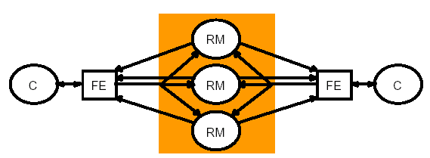
Active Replication
Multiple (group) replica managers (RM), each with equivalent roles
The RM’s operate as a group
Each front end (client interface) multicasts requests to a group of RM’s
requests processed by all RM’s independently (and identically)
client interface compares all replies received
can tolerate N out of 2N+1 failures, i.e. consensus when N+1 identical responses received
Can tolerate byzantine failure

Slide 24
Active Replication – how it works
Client request is sent to group of RM’s using totally ordered reliable multicast, each sent with unique request id
Each RM processes the request and sends response/result back to the front end
Front end collects (gathers) responses from each RM
Fault Tolerance:
Individual RM failures have little effect on performance. For n process fails need 2n+1 RM’s (to leave a majority n+1 operating).

Slide 25
The Gossip Architecture - 1
Concept: replicate data close to points where clients need it first. Aim is to provide high availability at expense of weaker data consistency
Framework for dealing with highly available services through use of replication
RM’s exchange (or gossip) in the background from time to time
Multiple replica managers (RM), single front end (FE) – sends query or update to any (one) RM
A given RM may be unavailable, but the system is to guarantee a service

Slide 26
The Gossip Architecture-2
Gossip in Distributed Systems
Requires lots of gossip message traffic
Not applicable for real-time work (difficult to guarantee consistency against fixed time limits)
Gossip architecture does not scale – the concept does, the performance does not
Performance optimization tradeoff e.g. make most RM’s read-only, providing a low proportion of update requests

Slide 27
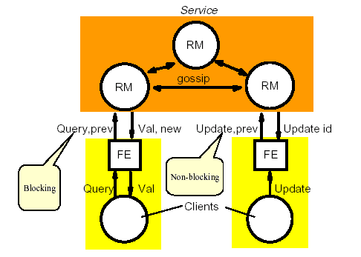
The Gossip Architecture-3
Clients request service operations that are initially processed by a front end, which normally communicates with only one replica manager at a time, although free to communicate with others if its usual manager is heavily loaded.

Slide 28
Reliable Group Communication
Problem: Provide guarantee that all members in a process group receive a message.
for small groups just use multiple point to point connections
Problem with larger groups:
with such complex communication schemes the probability of an error is increased
a process may join, or leave, a group
a process may become faulty, i.e. is a member of a group but unable to participate

Slide 29
Reliable Group Communication: simple case:
Where members of a group are known and fixed:
Sender assigns message sequence number to each message so that receiver can detect missing message.
Sender retains message (in history buffer) until all receivers acknowledge receipt.
Receiver can request missing message (reactive) so sender can resend if acknowledgement not received after a certain time (proactive).
Important to minimize number of messages, so combine acknowledgement with next message.

Slide 30
Non Hierarchical Feedback Control
Receivers only report missing messages, but multicasts its feedback to rest of group (hence allowing other receivers to suppress their own feedback)
sender then re-transmits missing message to all group.
Problem with this method:
Processes with no problems forced to receive extra messages.
Can form subgroups

Slide 31
Hierarchical Feedback Control
Best approach for large process groups
Subgroups organized into tree with local group typically on same LAN
Each subgroup has local coordinator holding message history buffer
Local coordinator communicates to coordinator of connecting groups
Local coordinator holds message until receipt of delivery received from all process members for group, then it can be deleted
Hierarchical schemes work well.
The main difficulty is in formation of the tree as this needs to be adjusted dynamically as membership changes. (balanced tree problems)

Slide 32
Recovery
Once failure has occurred in many cases it is important to recover critical processes to a known state in order to resume processing
Problem is compounded in distributed systems
Two Approaches:
Backward recovery, by use of checkpointing (global snapshot of distributed system status) to record the system state but checkpointing is costly (performance degradation)
Forward recovery, attempt to bring system to a new stable state from which it is possible to proceed (applied in situations where the nature if errors is known and a reset can be applied)

Slide 33
Backward Recovery
most extensively used in distributed systems and generally safest
can be incorporated into middleware layers
complicated in the case of process, machine or network failure
no guarantee that same fault may occur again (deterministic view – affects failure transparency properties)
can not be applied to irreversible (non-idempotent) operations, e.g. ATM withdrawall

Slide 34
Conclusion
Hardware, software and networks cannot be totally free from failures
Fault tolerance is a non-functional requirement that requires a system to continue to operate, even in the presence of faults.
Distributed systems can be more fault tolerant than centralized systems.
Agrement in faulty systems and reliable group communication are important problems in distributed systems.
Replication of Data is a major fault tolerance method in distributed systems.
Recovery is another property to consider in faulty distributed environments.

Slide 35
Any Questions
???

